Slide 1

Data Science Case Project
By –Rahul Dutta

Slide 2
I have done this with reference to the Online Advertising Performance Data Case project. The answers to the questions are provided slide-wise.

Slide 3
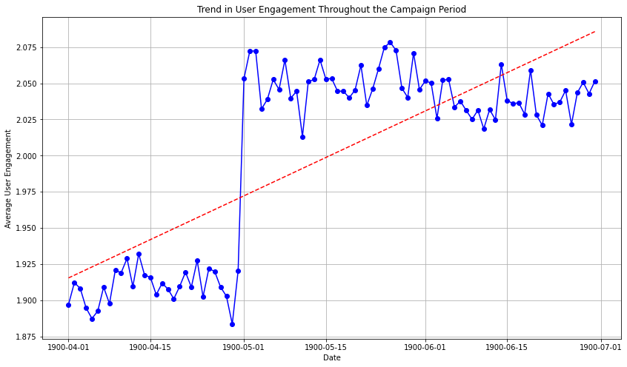
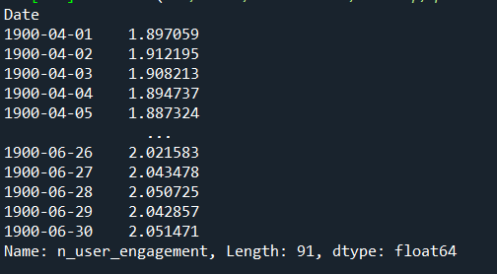
Answer to Question 1-

Slide 4
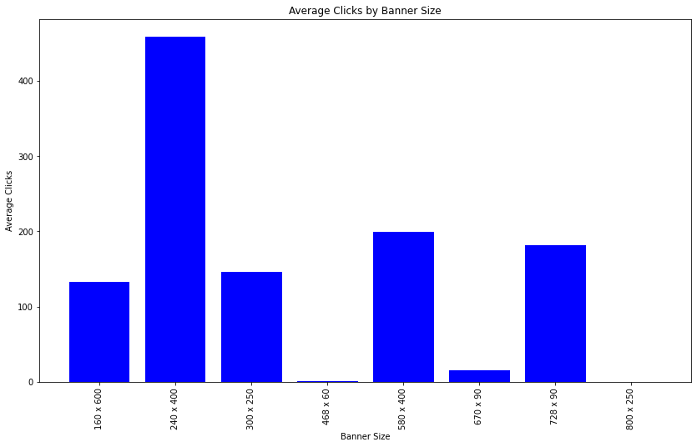
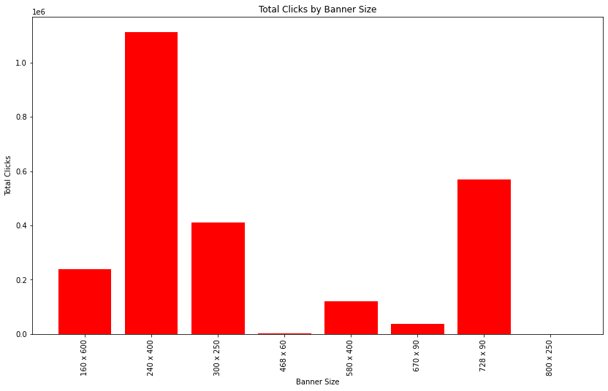
Answer to Question 2-

Slide 5
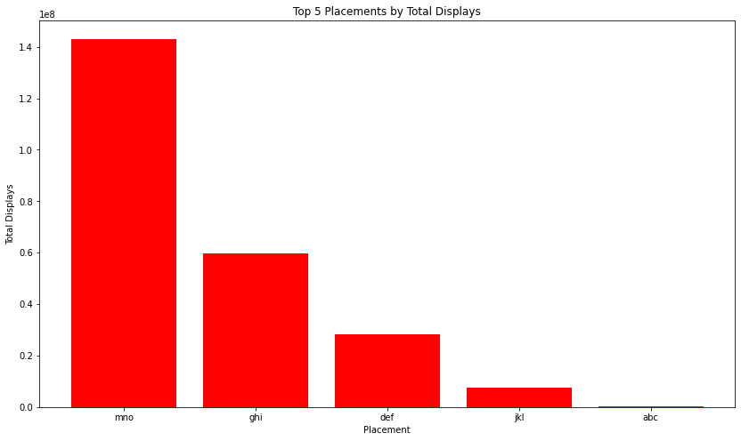
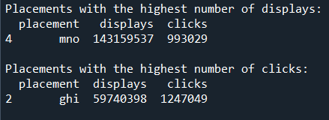
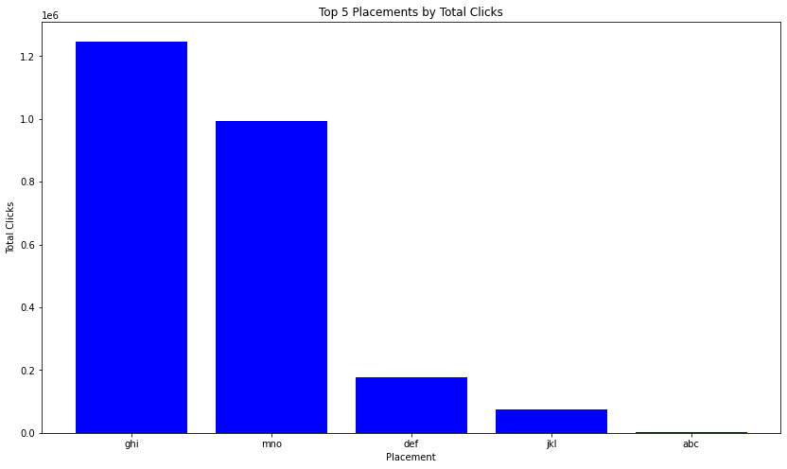
Answer to Question 3-

Slide 6
Answer to Question 4-

Slide 7
Answer to Question 5-

Slide 8
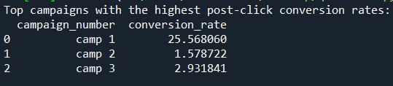
Answer to Question 6-

Slide 9
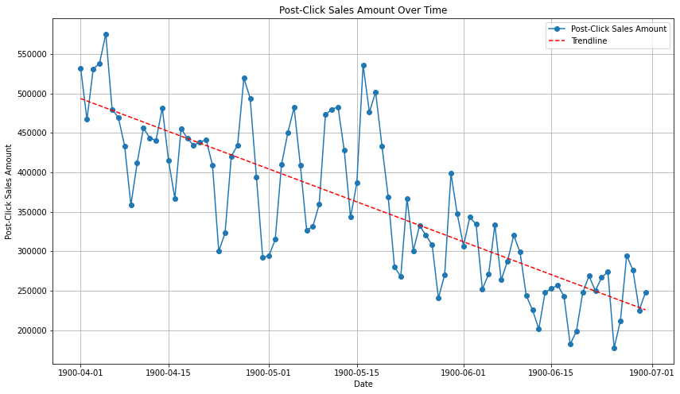
Answer to Question 7-

Slide 10
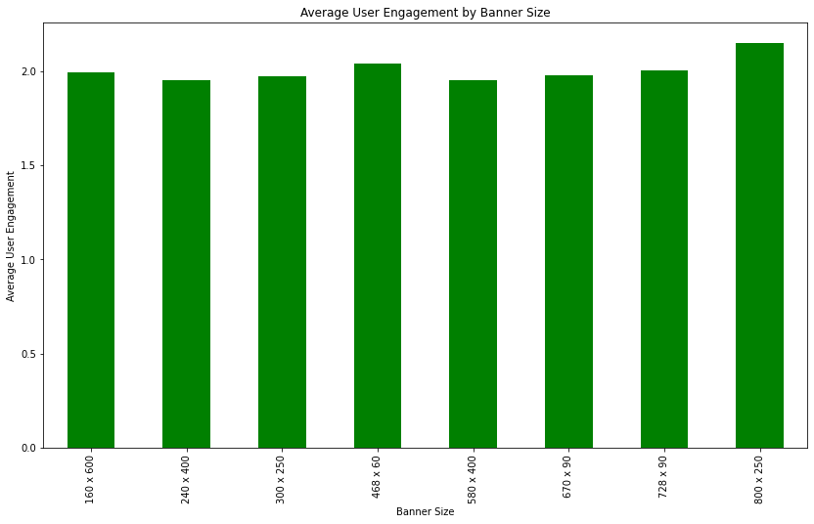
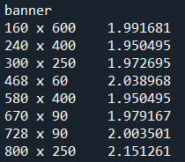
Answer to Question 8-

Slide 11
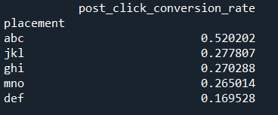
Answer to Question 9-

Slide 12
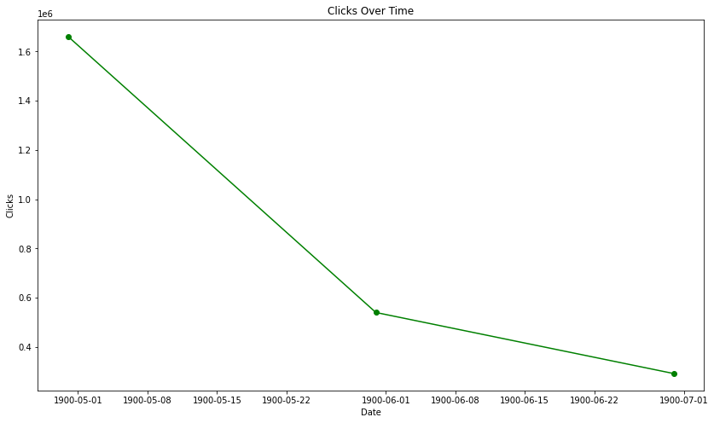
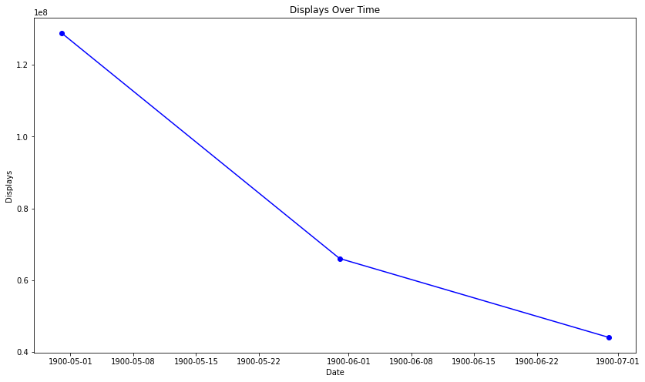
Answer to Question 10-

Slide 13
Answer to Question 11-

Slide 14
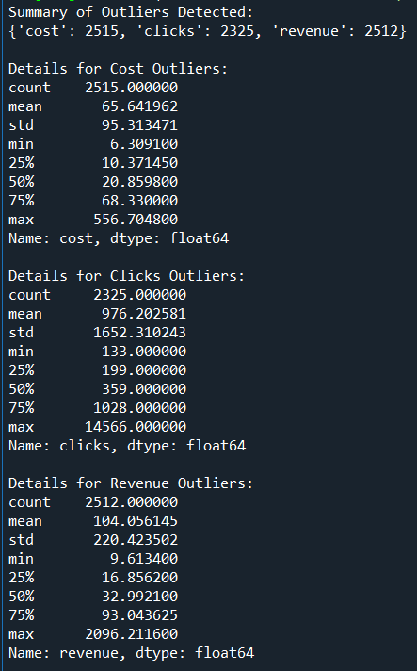
Answer to Question 12-

Slide 15
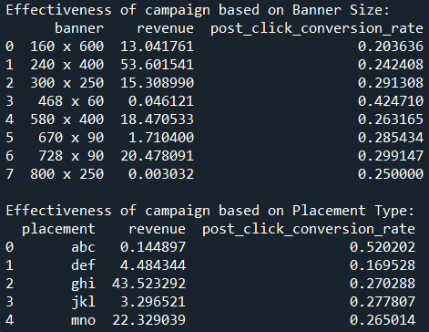
Answer to Question 13-

Slide 16
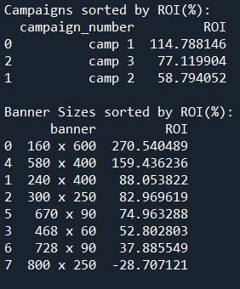
Answer to Question 14-

Slide 17
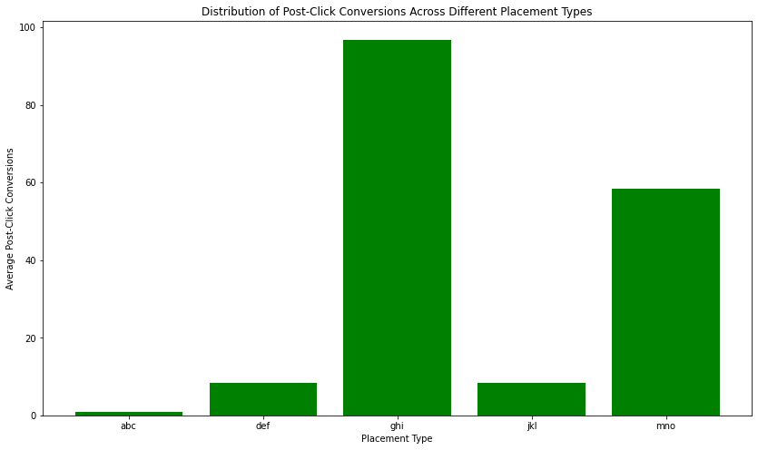
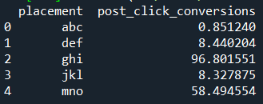
Answer to Question 15-

Slide 18
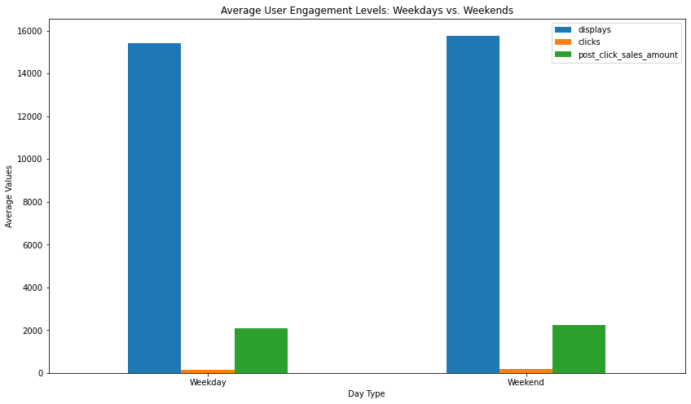

Answer to Question 16-

Slide 19
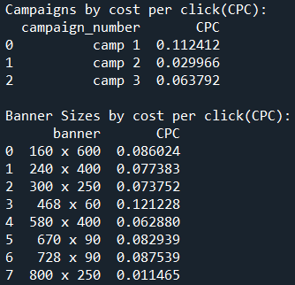
Answer to Question 17-

Slide 20
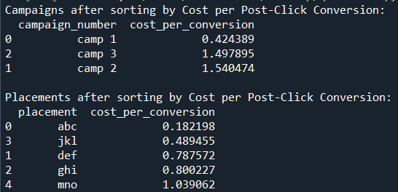
Answer to Question 18-

Slide 21
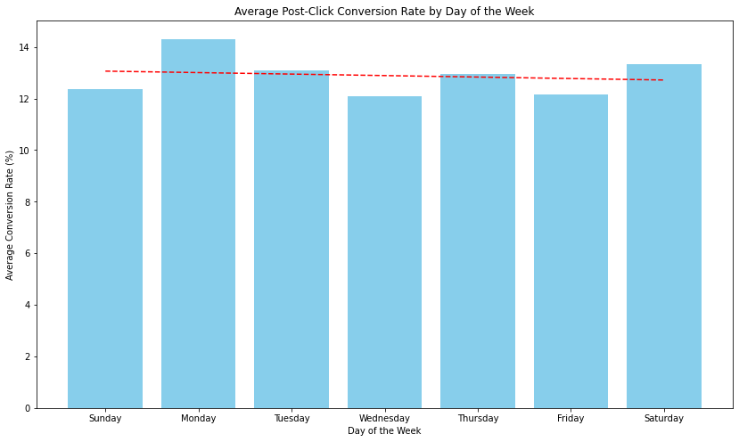
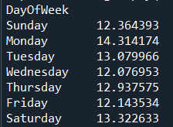
Answer to Question 19-

Slide 22
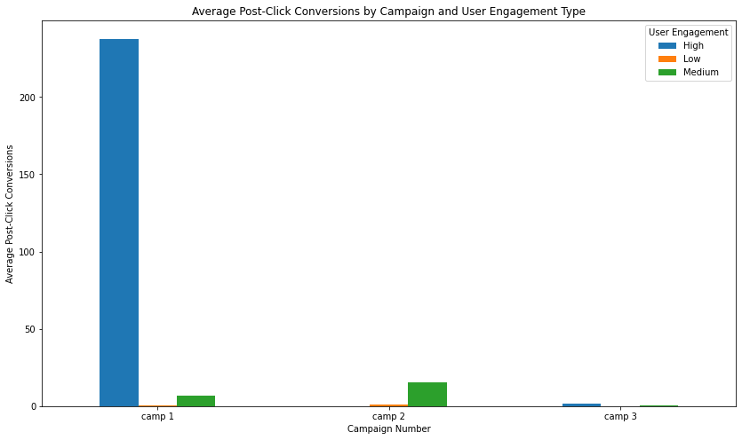
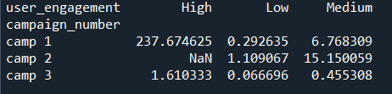
Answer to Question 20-

